Slide 1



Teaching of " Embedded System Design and Application "
Hadoop Big Data Technology
Department of Big Data Management and Application
Dai Jiagang
Notes:
https://www.renrendoc.com/paper/111762807.html
https://www.renrendoc.com/paper/111762807.html
Topic: Huffman codec system
Problem description: Open an English article, count the number of times each character appears in the article, and then encode each character using them as full-time. After the encoding is completed, decode the encoding
CDIO stands for Concept, Design, Implement and Operate. It takes the life cycle from product development to product operation as a carrier, allowing students to actively, practically and organically connect courses. The CDIO training outline divides the abilities of engineering graduates into four levels: basic engineering knowledge, personal ability, interpersonal team ability, and engineering system ability. The outline requires that students achieve the predetermined goals in these four levels through a comprehensive training method. .

Slide 2

" Big Data Basic Programming, Experiments and Case Studies (2nd Edition ) "
Textbook official website: http://dblab.xmu.edu.cn/post/bigdatapractice2/
Chapter 8 Installation and Use of

Slide 3
01
Demand Analysis

Slide 4
The need to transform to big data
For those who are used to traditional databases ( such as MySQL and Oracle) , they will be able to get started quickly when using HiveSQL because they are very familiar with traditional SQL , as they are similar to the basic SQL structure : Of course, HiveSQL has made some optimizations for distributed computing , and the following chapters will guide readers to practice in detail. This is also the purpose of understanding the principles of Hadoop and Hive . Only by understanding these things can we use them well.

Slide 5
The need to transform to big data
Since Hive queries use Hadoop 's MapReduce jobs, most query processes are batch operations, so like MapReduce , they have high latency , so Hive is not suitable for low-latency applications . At the same time, Hive does not support modification and appending of existing data.

Slide 6
Specific requirements
Get started quickly
01
Can use familiar SQL language for analysis
Low learning cost
key
02
Users do not need to be proficient in programming languages or MapReduce programming frameworks
Able to process massive amounts of data
03
Supports concurrent processing of massive data stored in the HDFS distributed file system

Slide 7
The need to transform to big data
What is
Distributed file systems are the infrastructure that supports the storage and computation of massive data . So, what is the infrastructure that supports data warehouses ?
Hive is the most common infrastructure in major enterprises. This section will take readers to understand the overview of Hive .

Slide 8

Advantages of Hive
Hive means beehive, hive, storage, and accumulation in English , which is similar to the meaning of a data warehouse that holds a large amount of valuable data. The left picture is the image logo of Hive , which looks like a flying bee, but has an elephant's head, indicating that it is the same company as Hadoop and is a data warehouse based on Hadoop .

Slide 9
Hive is also an open source framework under the Apache Foundation. It is a data warehouse tool based on Hadoop . It can map structured data files into a data warehouse table and provide simple SQL (Structured Query Language) query functions. The background converts SQL statements into MapReduce tasks for execution.
Advantages of Hive

Slide 10
Advantages of Hive
Hive and HBase are two different technologies based on Hadoop. Hive is a SQL- like engine that runs MapReduce tasks, and HBase is a NoSQL Key /Value database on top of Hadoop .

Slide 11
Advantages of Hive
The learning cost is low, it is easy to use, and the syntax is similar to SQL .
High compatibility, major Hadoop players have released and supported Hive .
Can process data stored in HDFS or HBase
Because HDFS is used to store data, it has good scalability and extensibility.

Slide 12

Disadvantages of Hive
Hive is not designed for online transaction processing and does not support real-time query and update operations well.
Hive has high startup overhead and high latency, and is not suitable for fast analysis of small amounts of data.
Hive needs to be converted into MapReduce jobs, it is usually inefficient and difficult to tune.
Due to the limitations of MapReduce itself, Hive cannot express iterative algorithms.

Slide 13
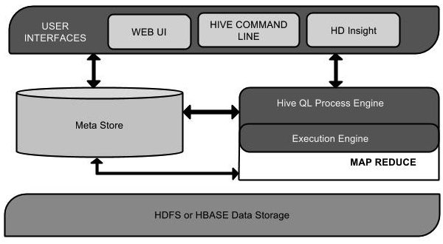
Hive Architecture
01
Hive provides multiple access methods such as command line, browser web page and API .
02
Hive supports using a MySQL database to store its own metadata.
03
Hive can directly access data stored in HDFS or HBASE .

Slide 14
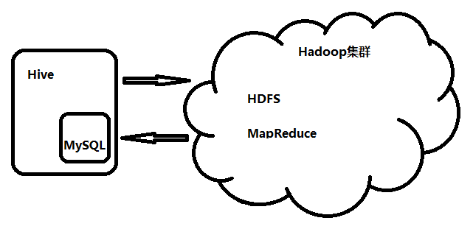
Hive operating environment
01
Hive is a tool and does not need to be deployed on a Hadoop cluster.
02
Hive needs to be deployed on a host that can access the Hadoop cluster.
03
Hive relies on MySQL to store metadata, and MySQL needs to be configured in the configuration file .

Slide 15
Hive table design - four types of tables supported by Hive
title
title
title
title
Internal table
External Table
Partition Table
Bucket table ( bucket table )
Please add the text you need. Please add the text you need. Please add the text you need. Please add the text you need. Please add the text you need. Please add the text you need. Please add the text you need. Please add the text you need.
Please add the text you need. Please add the text you need. Please add the text you need. Please add the text you need. Please add the text you need. Please add the text you need. Please add the text you need. Please add the text you need.
Please add the text you need. Please add the text you need. Please add the text you need. Please add the text you need. Please add the text you need. Please add the text you need. Please add the text you need. Please add the text you need.
Please add the text you need. Please add the text you need. Please add the text you need. Please add the text you need. Please add the text you need. Please add the text you need. Please add the text you need. Please add the text you need.
When you delete an internal table, the related metadata and data on HDFS are also deleted.
When deleting an external table, only the table information (metadata) is deleted.
Use different directories to organize tables into partitions to improve the efficiency of queries that limit partitions.
Use hash values to further divide data and improve query efficiency.
Notes:
Several common tables in
https://blog.csdn.net/2301_77257988/article/details/136185751
1. Internal table (management table)
The tables created by default are all management tables / internal tables. The table data is stored in the warehouse directory by default. During the data loading process, the actual data will be moved to the warehouse directory. When the table is deleted, the table data and metadata will be Will be deleted at the same time, the management table is not suitable for sharing data with other tools.
2. External table ( external ) key points
The table is an external table, so Hive does not consider that it owns the data completely. Deleting the table will not delete the data, but the metadata describing the table will be deleted.
3. Partition table Creating a partition table is to prevent brute force scanning of the entire table and improve query efficiency. The partition field does not exist in the source file and needs to be manually specified when adding data. Each partition corresponds to a directory. Use partitioned by to add partition fields when creating a partition table. Usage scenario: The partition table can be used to distinguish the data collected every day, and the query efficiency can be improved by specifying partitions when querying statistics.
4. Bucket table
Buckets are a more fine-grained division of data ranges than tables or partitions. Buckets are organized for a column, and the column value is hashed and then divided by the number of buckets to determine which bucket the record should be stored in.
You need to set it first: set hive.enforce.bucketing = true;
Create a bucket table:

Slide 16
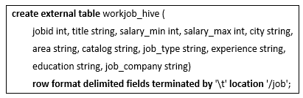
Hive Table Design
Because the original data is collected and stored by other systems, we use external tables to manage it. In this way, when we delete the table structure, it will not affect the original data.
01
external
Indicates that an external table is created and the file is not deleted when the table is deleted
02
location
Specify the location of external data files
03
row format delimited fields terminated by
Specifies the separator between fields.
Notes:
9.1.2 Hive deployment In order to help readers get a quicker understanding of Hive , we will now deploy a set of Hive . The official website of Hive is located at : p:/hive apache.org/, and readers can find a released version of Hive in the Downloads section. This chapter takes Hive 1.2.1 as an example to explain the configuration of Hive in order to complete the subsequent practice.

Slide 17
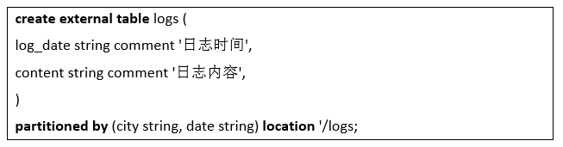
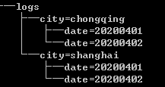
Definition
Partition table uses partitioned By is used to specify the partition field and the type of the partition field. There can be multiple partition fields:
partitioned by ( partition field 1 type 1, partition field 2 type 2, ..., partition field n type n)
01
The following partition fields are treated as subdirectories in the directory structure.
02
The partition directory format is "partition field name = partition field value"

Slide 18
Common Hive DDL commands
Serial number | Statements | illustrate
1 | create database < database name >; | Create a database
2 | show database; | View the database list
3 | use < database name >; | Use the specified database
4 | show tables; | View Table List
5 | create table < table name > | Create Table
6 | drop table < table name > | Delete a table
7 | alter table < table name > | Modify table structure
8 | truncate table | Clear table data
9 | desc < table name > | View the table description

Slide 19
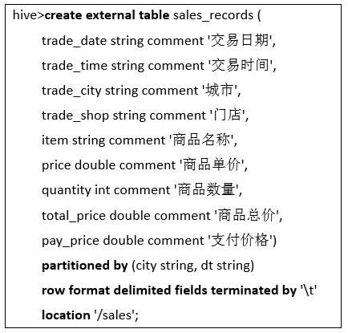
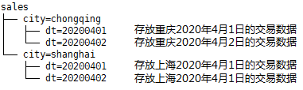
Create a partition table for sales data
We specify two partition fields, first partitioning by city ( city ), and then partitioning by date ( dt ). The final directory structure on HDFS will correspond to a two-layer directory structure. The directory structure seen on HDFS will be roughly like the following figure:

Slide 20

Create database and table
Create a database for the recruitment information that needs to be analyzed this time
For recruitment data, create the following external table

Slide 21
8.3 Basic Hive Operations
8.3.1 Create database, table, and view
8.3.2 Deleting Databases, Tables, and Views
8.3.3 Modify database, table, and view
8.3.4 View databases, tables, and views
8.3.5 Describe databases, tables, and views
8.3.6 Loading Data into a Table
8.3.7 Querying Data in Tables
8.3.8 Inserting data into or exporting data from a table

Slide 22
8.3.1 Create database, table, and view
Create a database
Create a database hive
hive> create database hive;
Create a database hive . Because hive already exists, an exception will be thrown. If you add the if not exists keyword, no exception will be thrown.
hive> create database if not exists hive;
Create Table
In the hive database, create a table usr with three attributes: id , name , age
hive> use hive;
hive>create table if not exists usr (id bigint,name string,age int );
In the hive database, create a table usr with three attributes id , name , age , and a storage path of " / usr /local/hive/warehouse/hive/ usr "
hive>create table if not exists hive.usr(id bigint,name string,age int )
>location '/ usr /local/hive/warehouse/hive/ usr ';
Notes:
Examples of image presentation:
( 1 ) Use the put command to insert data
( 2 ) Use the scan command to browse the relevant information of the tempTable table
22

Slide 23
8.3.1 Create database, table, and view
Create Table
In the hive database, create an external table usr with three attributes id , name , and age , which can read data separated by "," in the path " / usr /local/data" .
hive>create external table if not exists hive.usr(id bigint,name string,age int )
>row format delimited fields terminated by ','
location '/ usr /local/data';
In the Hive database, create a partition table usr with three attributes id , name , age , and a partition field sex .
hive>create table hive.usr(id bigint,name string,age int ) partition by(sex boolean );
In the hive database, create partitioned table usr1 , which is obtained by copying table usr .
hive> use hive;
hive>create table if not exists usr1 like usr ;
Creating a View
Create a view little_usr that only contains the id and age attributes from the usr table
hive>create view little_usr as select id,age from usr ;
Notes:
Examples of image presentation:
( 1 ) Use the put command to insert data
( 2 ) Use the scan command to browse the relevant information of the tempTable table
23

Slide 24
8.3.2 Deleting Databases, Tables, and Views
Deleting a Database
Delete the hive database . If it does not exist, a warning will be displayed.
hive> drop database hive;
Delete the database hive . Because there is an if exists keyword, no exception will be thrown even if it does not exist.
hive>drop database if not exists hive;
Delete the database hive , add the cascade keyword, you can delete the current database and the tables in the database
hive> drop database if not exists hive cascade;
Notes:
Examples of image presentation:
( 1 ) Use the put command to insert data
( 2 ) Use the scan command to browse the relevant information of the tempTable table
24

Slide 25
8.3.2 Deleting Databases, Tables, and Views
Delete a table
Delete table usr . If it is an internal table, both metadata and actual data will be deleted. If it is an external table, only metadata will be deleted without deleting actual data.
hive> drop table if exists usr ;
Deleting a View
Delete the view little_usr
hive> drop view if exists little_usr ;
Notes:
Examples of image presentation:
( 1 ) Use the put command to insert data
( 2 ) Use the scan command to browse the relevant information of the tempTable table
25

Slide 26
8.3.3 Modify database, table, and view
Modify the database
Set the dbproperties key-value pair property value for the hive database to describe the database property information
hive> alter database hive set dbproperties ('edited-by'='lily');
Modify Table
Rename table usr to user
hive> alter table usr rename to user;
Add a new partition to table usr
hive> alter table usr add if not exists partition(age=10);
Delete the partition in table usr
hive> alter table usr drop if exists partition(age=10);
the name of the column in the usr table to username and place the column after the age column.
hive>alter table usr change name username string after age;
Notes:
Examples of image presentation:
( 1 ) Use the put command to insert data
( 2 ) Use the scan command to browse the relevant information of the tempTable table
26

Slide 27
8.3.3 Modify database, table, and view
Modify Table
the table usr , add a new column sex
hive>alter table usr add columns(sex boolean );
Delete all fields in table usr and reassign new fields newid , newname , newage
hive>alter table usr replace columns( newid bigint,newname string,newage int );
Set the tblproperties key-value pair attribute value for the usr table to describe the attribute information of the table
hive> alter table usr set tabproperties ('notes'='the columns in usr may be null except id');
Modify a view
Modify the tblproperties attribute information in the little_usr view metadata
hive> alter view little_usr set tabproperties (' create_at '='refer to timestamp');
Notes:
Examples of image presentation:
( 1 ) Use the put command to insert data
( 2 ) Use the scan command to browse the relevant information of the tempTable table
27

Slide 28
8.3.4 View databases, tables, and views
View Database
View all databases included in Hive
hive> show databases;
View all databases starting with h in Hive
hive>show databases like 'h.*';
Viewing Tables and Views
View all tables and views in the database hive
hive> use hive;
hive> show tables;
View all tables and views starting with u in the hive database
hive> show tables in hive like 'u.*';
Notes:
Examples of image presentation:
( 1 ) Use the put command to insert data
( 2 ) Use the scan command to browse the relevant information of the tempTable table
28

Slide 29
8.3.5 Describe databases, tables, and views
Describing the database
View the basic information of the database hive , including the file location information in the database, etc.
hive> describe database hive;
View the detailed information of the database hive , including the basic information and attribute information of the database
hive>describe database extended hive;
Describing Tables and Views
View the basic information of table usr and view little_usr , including column information, etc.
hive> describe hive.usr/ hive.little_usr ;
View detailed information about the table usr and view little_usr , including column information, location information, attribute information, etc.
hive> describe extended hive.usr/ hive.little_usr ;
View the information of column id in table usr
hive> describe extended hive.usr.id;
Notes:
Examples of image presentation:
( 1 ) Use the put command to insert data
( 2 ) Use the scan command to browse the relevant information of the tempTable table
29

Slide 30
8.3.6 Loading Data into a Table
Load the data in the data file under the directory ' / usr /local/data' into the usr table and overwrite the original data
hive> load data local inpath '/ usr /local/data' overwrite into table usr ;
Load the data in the data file under the directory ' / usr /local/data' into the usr table without overwriting the original data
hive> load data local inpath '/ usr /local/data' into table usr ;
Load the data files in the distributed file system directory ' hdfs://master_srever/usr/local/data' into the usr table and overwrite the original data
hive> load data inpath 'hdfs://master_srever/usr/local/data'
>overwrite into table usr ;
Notes:
Examples of image presentation:
( 1 ) Use the put command to insert data
( 2 ) Use the scan command to browse the relevant information of the tempTable table
30

Slide 31
8.3.7 Querying Data in Tables
This command is exactly the same as the SQL statement and will not be repeated here.

Slide 32
The future and development of Hive
Using Hive for data analysis certainly brings huge benefits, such as low learning cost , the ability to use SQL- like languages to analyze massive amounts of data, and the ability to use MapReduce for parallel computing (also known as Hive on MR ) without writing MapReduce programs . It is a very good solution when the amount of data is so large that ordinary relational databases cannot handle it. However, its inherent defects are also very obvious. Since queries are converted into MapReduce jobs, the startup cost is relatively high, and the processing speed is also limited by the MapReduce job itself.
To solve these problems, Hive is constantly being optimized to provide higher performance. On the other hand, Spark can be used for parallel computing, which is the Hive on Spark solution . Using Hive on Spark can provide higher analysis efficiency.

